Slide 1
Building Software with Agentic AI:
Benefits, Limitations, and Best Practices
Alexandru Lungu, Senior Software Developer | Full-Stack

Slide 2


Slide 3
Agenda
Intro
Demo time
Agentic AI capabilities
Benefits and limitations of AI
A place for humans, in the Agentic AI world
How to use AI in current (brownfield) and new projects (greenfield)
Agent comparison: GitHub Copilot vs. Claude Code
Q&A

Slide 4
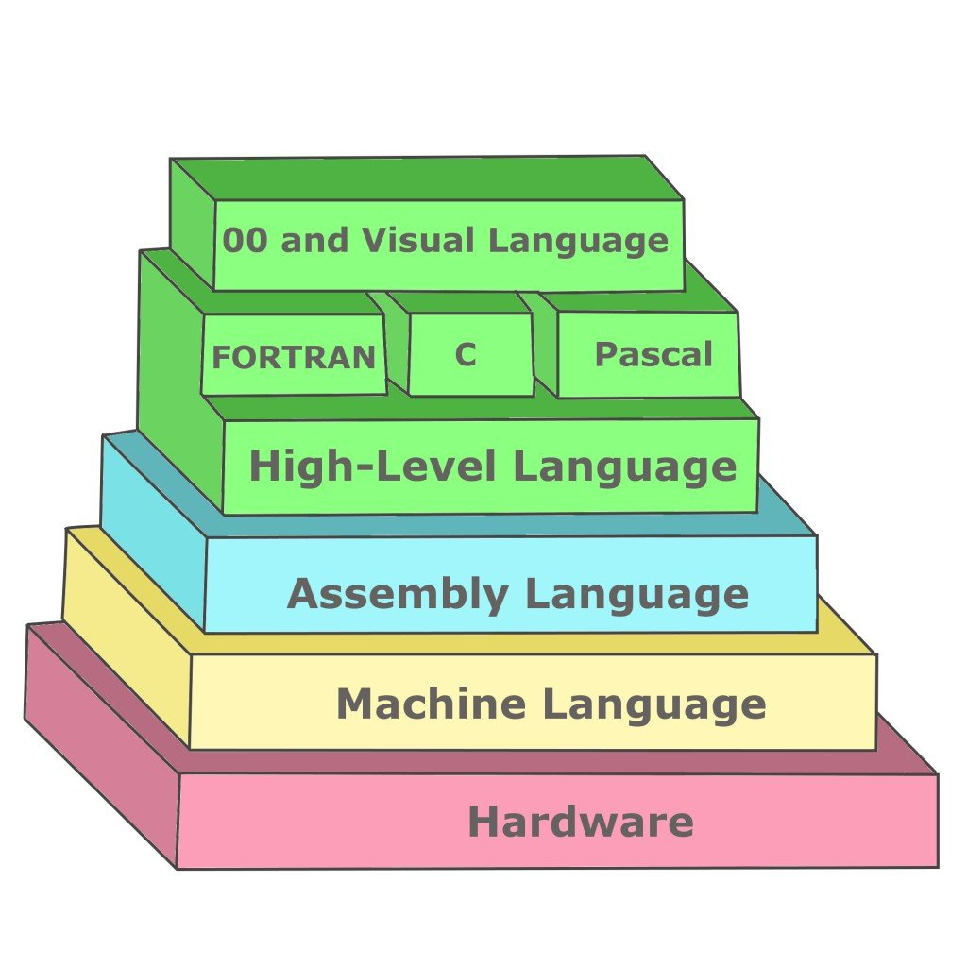
1. Intro: Agentic AI = another level of abstraction/delegation
Agentic AI

Slide 5


Slide 6
User + Copilot agent=
Harness
LLM
Agent = Harness + LLM

Slide 7
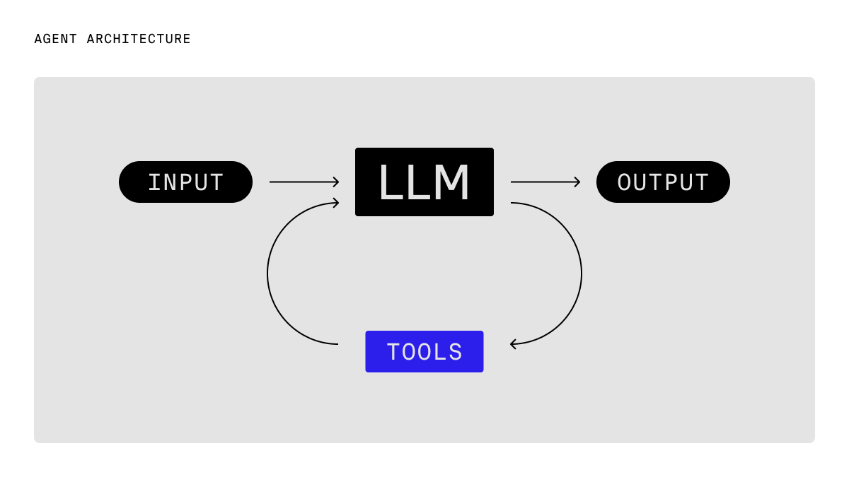

Slide 8
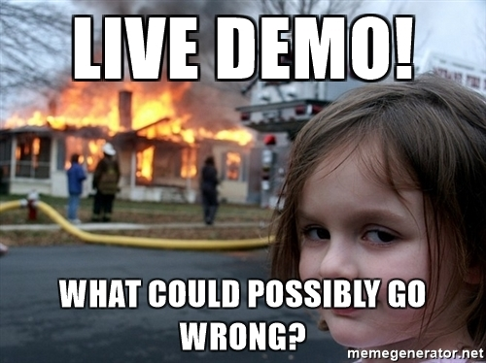
2. Demo ☺

Slide 9
3. Agentic AI capabilities (will reduce AI hallucinations/limitations )
Custom Agent – only select relevant tools. This saves space in context windows
Prompt Template – common prompts can be saved as templates
Instructions – Layers of architecture can be modeled as instruction.md files
Skills-help the agent to learn a certain skill.
  https://github.com/supabase/agent-skills/blob/main/skills/supabase-postgres-best-practices/SKILL.md
  draw abstract pictures: https://github.com/anthropics/skills/blob/main/skills/algorithmic-art/SKILL.md
Tools functions that an agent can call
MCP – API for Agents
Agent Loop negative feedback loop
Tools- business specific or public functions that the agent can access. E.g get_weather(city_name)
Context Window- agent memory (user/system chat + all chat/response history )
Planning Mode – human will review the plan and fix open items that the agent may have
Agentic Mode – implementation after the planning mode

Slide 10
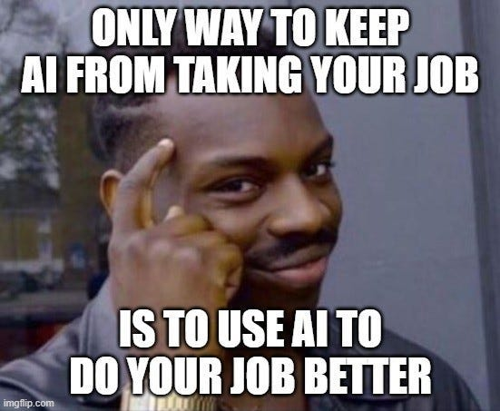

Slide 11
4. Benefits and limitations of agentic AI
Benefits of Agentic AI | Limitations of Agentic AI
Automates complex multi-step tasks with minimal human intervention | May make incorrect decisions due to flawed reasoning or data
Improves productivity by handling repetitive and time-consuming work | Requires strong governance and oversight to prevent errors
Adapts dynamically to changing situations and goals | Can be difficult to explain or audit decision-making processes
Enables 24/7 operation and faster response times | Security and privacy risks increase with greater autonomy
Coordinates across tools, systems, and workflows to achieve outcomes | Implementation and maintenance can be costly and complex
Summary: Agentic AI excels at autonomous task execution, adaptability, and productivity gains, but organizations must address challenges related to accuracy, transparency, security, and governance.

Slide 12


Slide 13
5. A place for humans, in the Agentic AI world
Humans can compensate the things that AI can’t do:
Be a supervisor/tech-lead of the AI agent/agents
Do design and review the AI’s work:
e.g. plan mode -agent work- review (code review)
Reduce hallucinations with instructions/skill.md
Use planning mode to review and correct the agent’s plan
Use critical thinking to check the agent reasoning
e.g: why should I learn agentic AI. Use the six hats
Fundamental matter. AI is just a layer, on top of what was required in the past
System design and System thinking

Slide 14
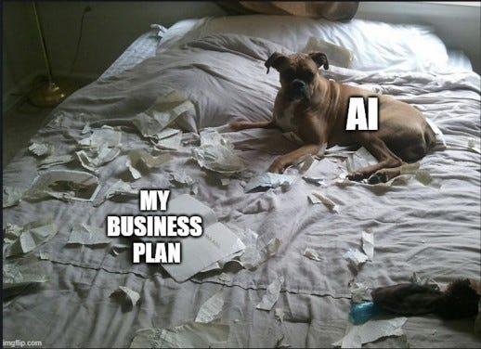

Slide 15


6. How to use AI in current (brownfield) and new projects (greenfield)

Slide 16
6. How to use AI in current (brownfield) and new projects (greenfield)

Slide 17
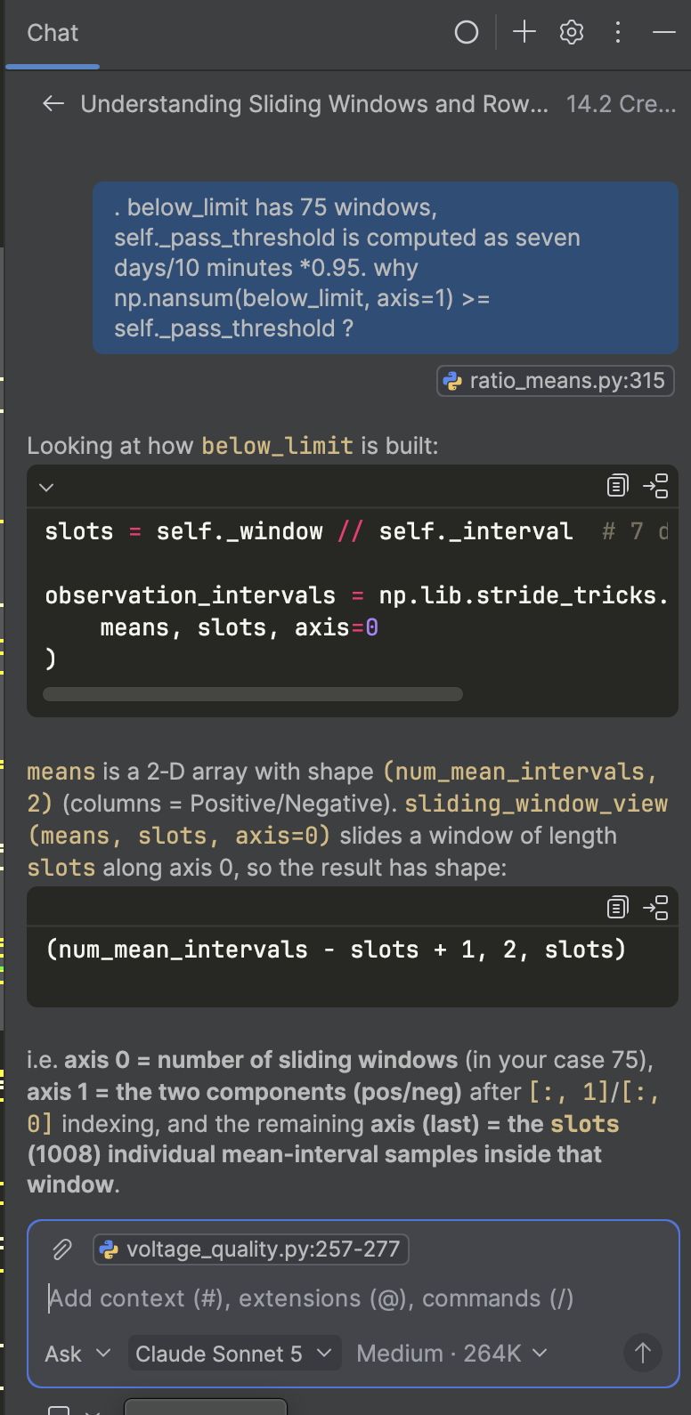

Slide 18
7. Agent comparison: GitHub Copilot vs. Claude Code

Slide 19
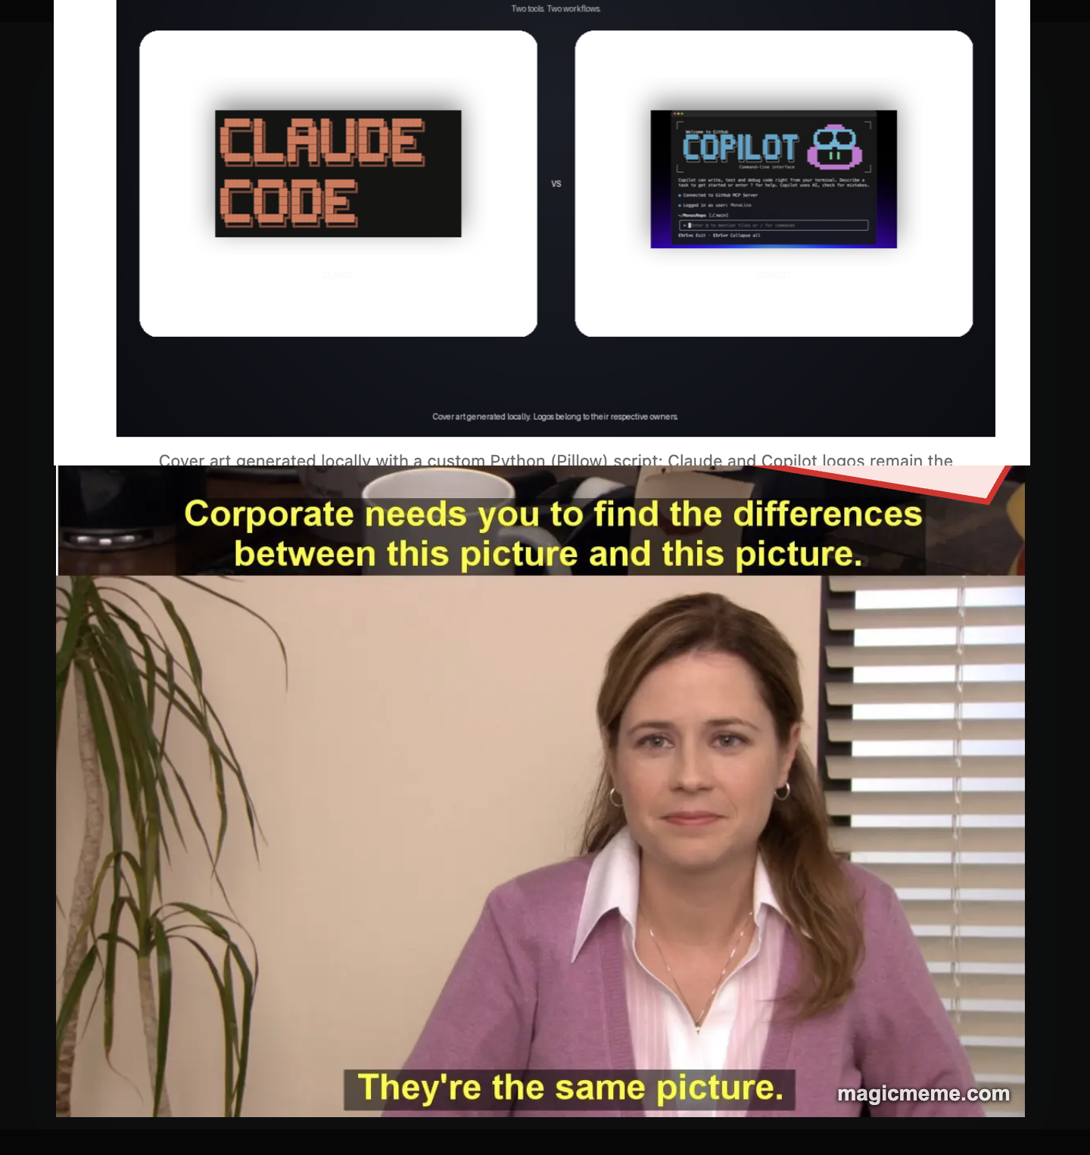

Slide 20
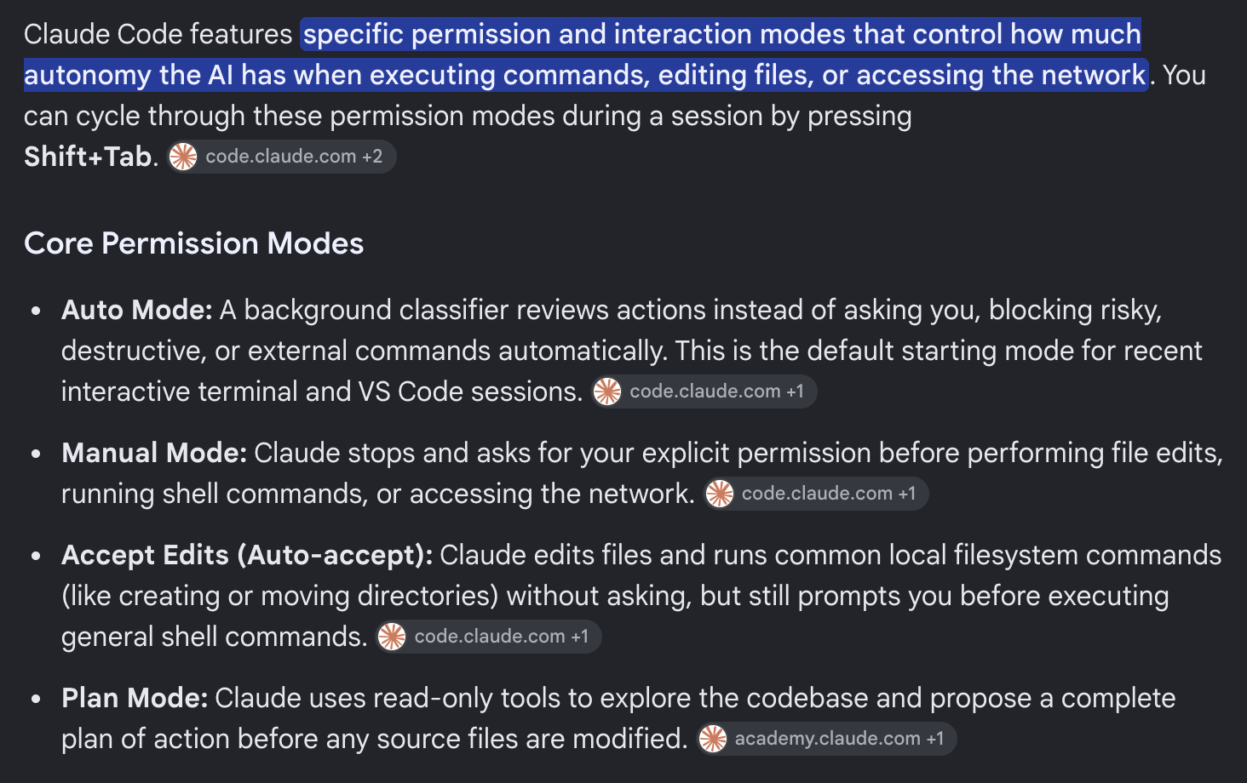

Slide 21
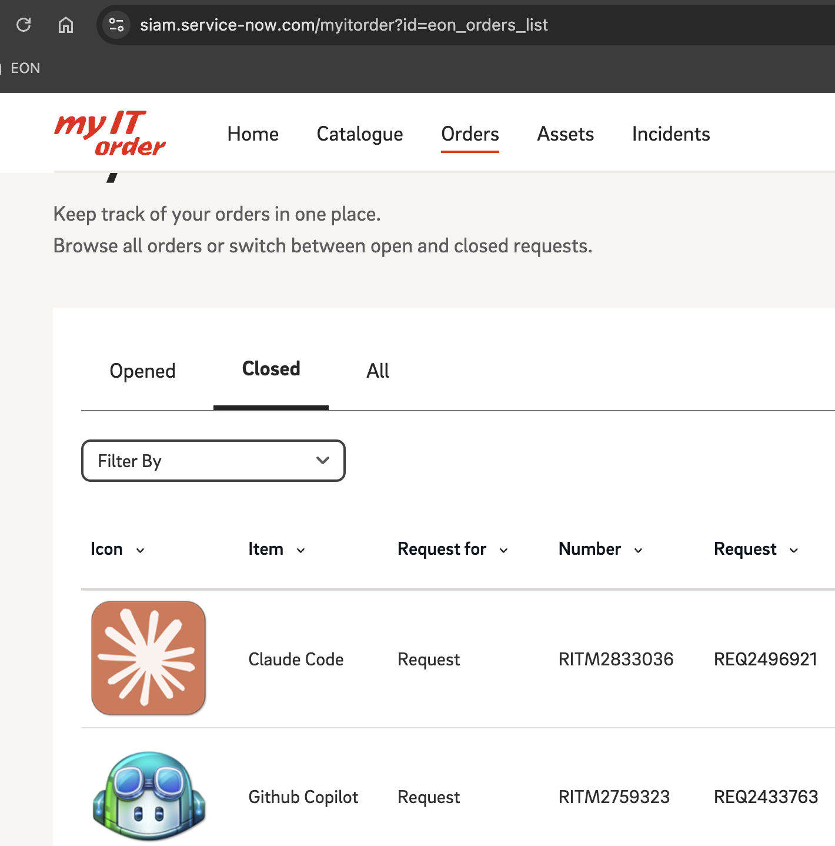

Slide 22

Questions ?
https://github.com/alex011235/smart-asset-copilot
Alexandru Lungu
alexandru.lungu@eon.com
https://github.com/alex011235/smart-asset-copilot

Slide 23

Thank you for your presence.
https://github.com/alex011235/smart-asset-copilot
Alexandru Lungu
alexandru.lungu@eon.com

Slide 24

Thank you

